Slide 1
Hand Biometrics
Ravitha N

Slide 2
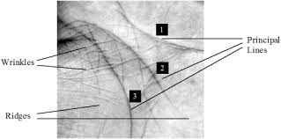

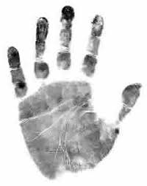
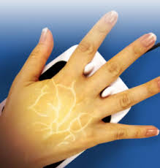
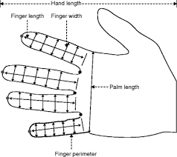
Hand Biometrics

Slide 3
Discussion
Hand Morphology
Simplest to acquire
Encodes the relative distance between finger and the palm
Drawbacks : Deformations
Cannot be integrated into portable device
Contactless Biometrics
Features – Ridge Patterns

Slide 4
Characterization by Minutiae extraction
Conversion of the image into double
Mean of the Image
Operations on neighbors
Number of the Neighbors
Save the new image

Slide 5
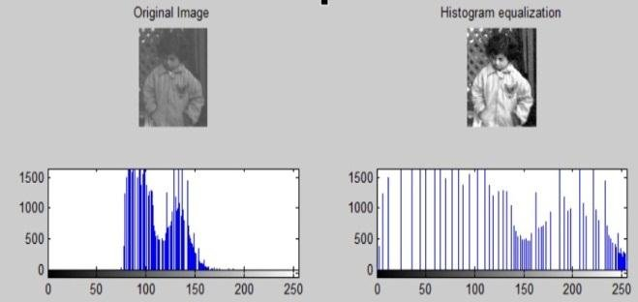
Histogram equalization
Uses the principle of information entropy

Slide 6
Histogram Equalization
Compute Mean for entire image (M)
Compute std (s) and mean (m) considering local neighborhood at every pixel position in the image
New pixel = (M/s).* (pixel-m) + m

Slide 7
Transfer Function
M = 128
s = 1
T = 128/1 * (I –m) + m F = 128
M = 128
S = 100
T = 128/100 * (I - m) + m F = 1.28

Slide 8
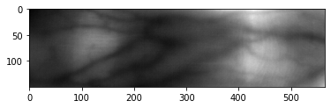
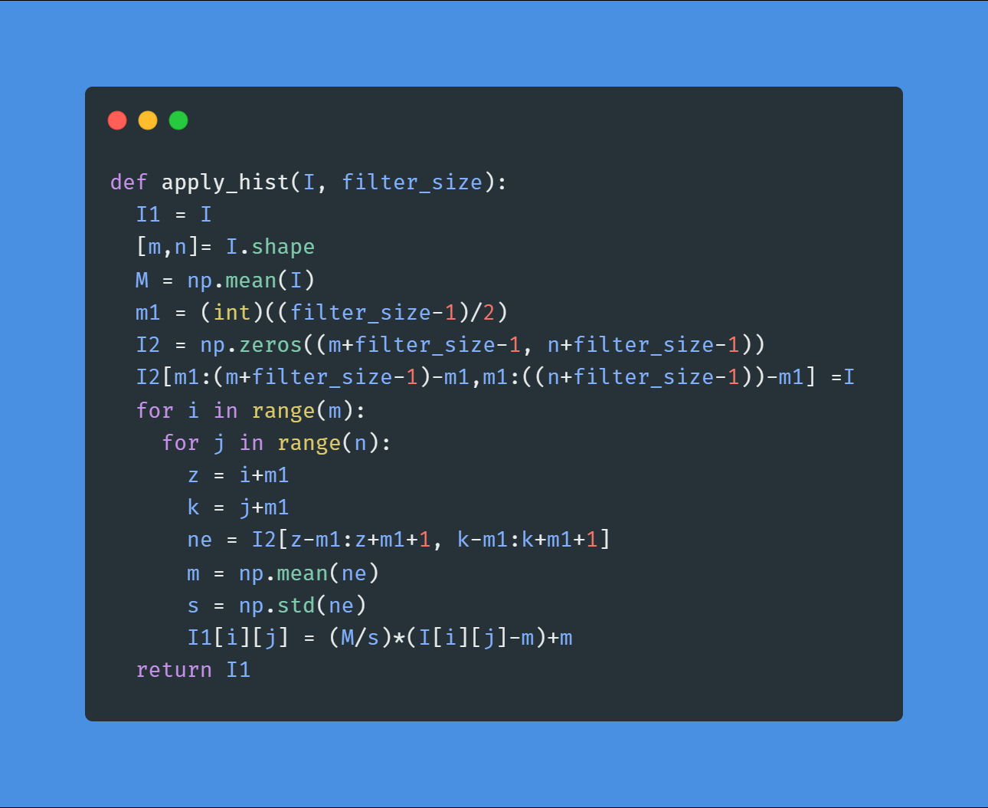
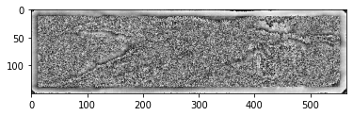

Slide 9
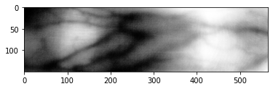
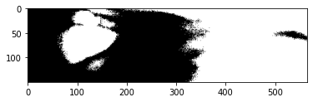
from skimage import exposure
img_eq = exposure.equalize_hist(I)
plt.imshow(img_eq,cmap='gray')

Slide 10
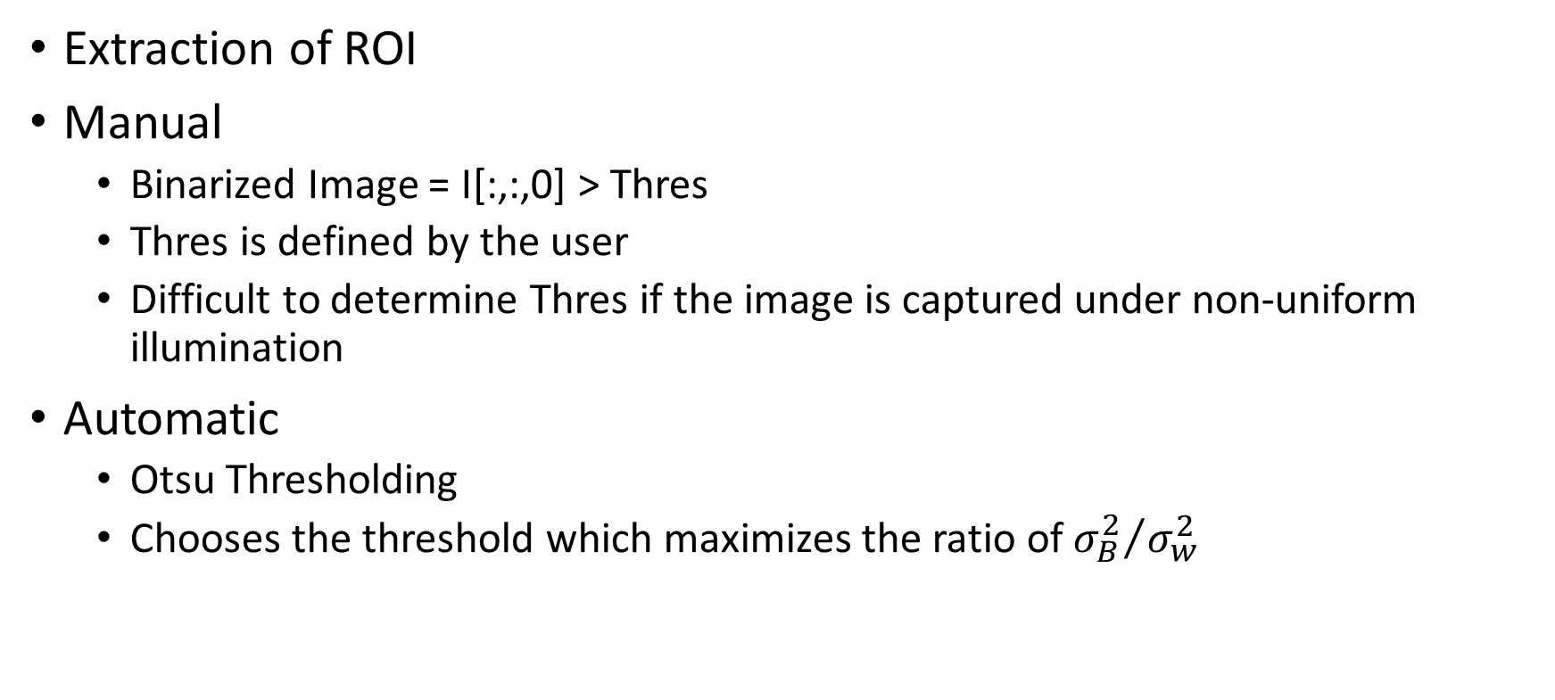
Binarization
Extraction of ROI
Manual
Binarized Image = I[:,:,0] > Thres
Thres is defined by the user
Difficult to determine Thres if the image is captured under non-uniform illumination
Automatic
Otsu Thresholding
Chooses the threshold which maximizes the ratio of ${σ_{B}^{2}}/{σ_{w}^{2}}$

Slide 11
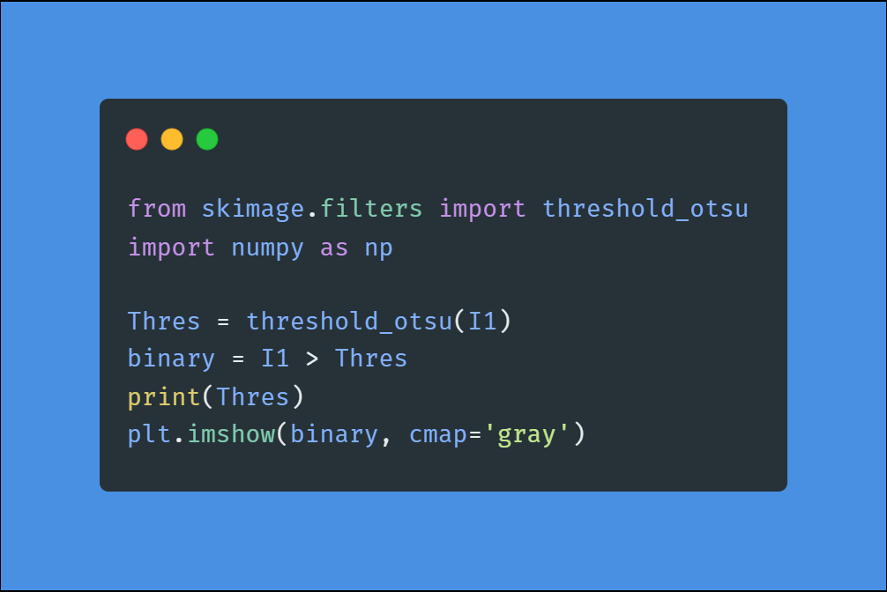
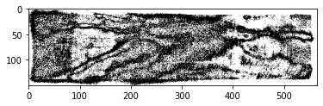

Slide 12
Postprocessing
Remove small objects which are less than 3 pixels
Use median filtering to remove noisy pixels that are very different from the background

Slide 13
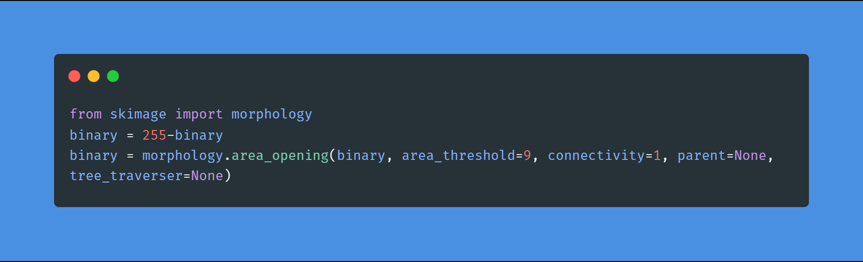
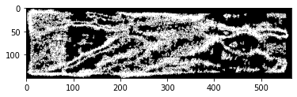
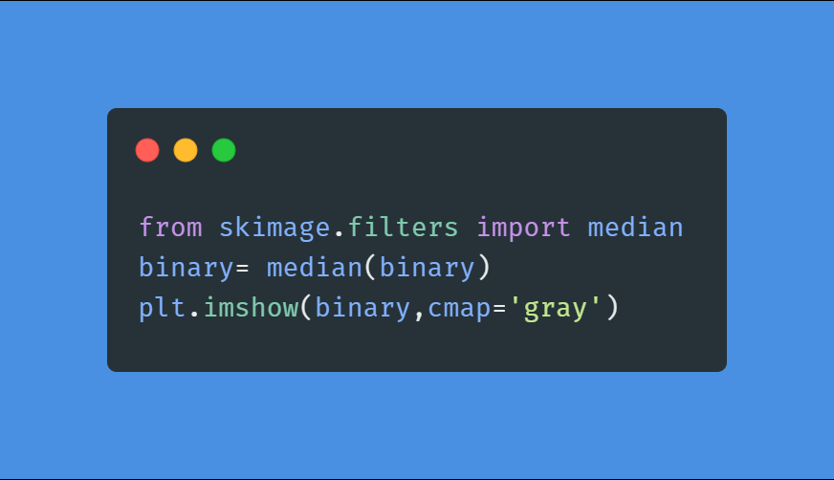
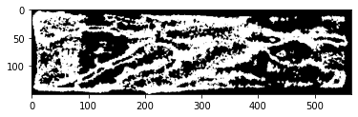

Slide 14
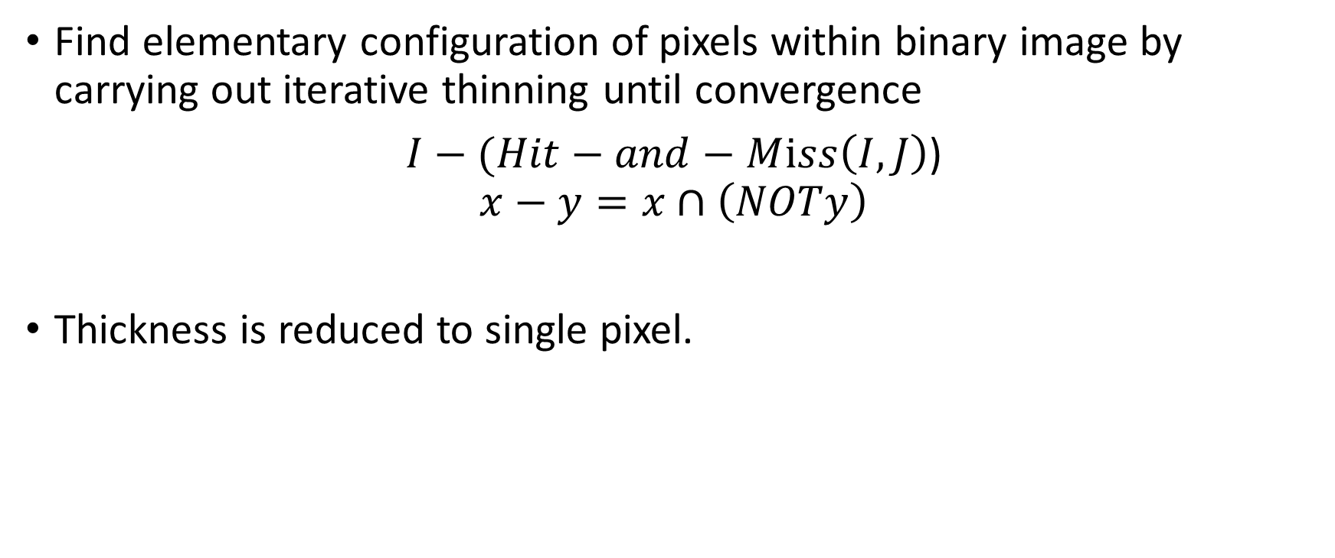
Skeletonization (or) thinning
Find elementary configuration of pixels within binary image by carrying out iterative thinning until convergence
$I−(Hit−and−Mⅈss\left(I,J\right)$)
$$x−y=x∩\left(NOTy\right)$$
Thickness is reduced to single pixel.

Slide 15
0 | 0 | 0
 | 1
1 | 1 | 1
Applying I – Hit and Miss

Slide 16
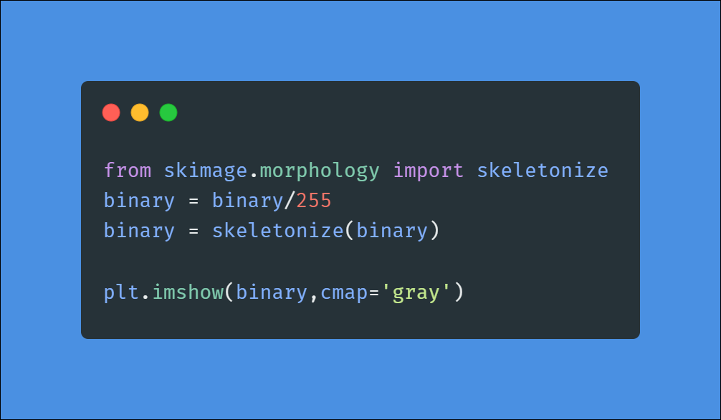
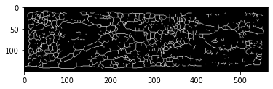

Slide 17
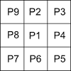
Thinning using Zhang-Suen Algorithm
Iterative algorithm
Step 1:
Number of neighbors that take a value of 1 should be between 2 to 6
Number of 0->1 transitions in p2,p3,p4…p9p2 = 1
P2.P4.P6=0
P4.P6.P8=0
If all the conditions are satisfied, then flag the corresponding pixel.
Once all the pixels are checked, change the value of flagged pixels to 0
Step 2:
Number of neighbors that take a value of 1 should be between 2 to 6
Number of 0->1 transitions in p2,p3,p4…p9p2 = 1
P2.P6.P8=0
P4.P2.P8=0
If all the conditions are satisfied, then flag the corresponding pixel.
Once all the pixels are checked, change the value of flagged pixels to 0

Slide 18
Thinning using Zhang-Suen Algorithm
0 | 0 | 0 | 0 | 0 | 0 | 0 | 0 | 0 | 0 | 0 | 0
0 | 0 | 1 | 1 | 1 | 1 | 1 | 1 | 1 | 1 | 0 | 0
0 | 1 | 1 | 1 | 1 | 0 | 0 | 1 | 1 | 1 | 1 | 0
0 | 1 | 1 | 1 | 0 | 0 | 0 | 0 | 1 | 1 | 1 | 0
0 | 1 | 1 | 1 | 0 | 0 | 0 | 0 | 0 | 0 | 0 | 0
0 | 1 | 1 | 1 | 0 | 0 | 0 | 0 | 0 | 0 | 0 | 0
0 | 1 | 1 | 1 | 0 | 0 | 0 | 0 | 1 | 1 | 1 | 0
0 | 1 | 1 | 1 | 1 | 0 | 0 | 1 | 1 | 1 | 1 | 0
0 | 0 | 1 | 1 | 1 | 1 | 1 | 1 | 1 | 1 | 0 | 0
0 | 0 | 0 | 0 | 0 | 0 | 0 | 0 | 0 | 0 | 0 | 0
Iteration 1
0 | 0 | 0 | 0 | 0 | 0 | 0 | 0 | 0 | 0 | 0 | 0
0 | 0 | 1 | 1 | 1 | 1 | 1 | 1 | 1 | 1 | 0 | 0
0 | 1 | 1 | 1 | 1 | 0 | 0 | 1 | 1 | 1 | 1 | 0
0 | 1 | 1 | 1 | 0 | 0 | 0 | 0 | 1 | 1 | 1 | 0
0 | 1 | 1 | 1 | 0 | 0 | 0 | 0 | 0 | 0 | 0 | 0
0 | 1 | 1 | 1 | 0 | 0 | 0 | 0 | 0 | 0 | 0 | 0
0 | 1 | 1 | 1 | 0 | 0 | 0 | 0 | 1 | 1 | 1 | 0
0 | 1 | 1 | 1 | 1 | 0 | 0 | 1 | 1 | 1 | 1 | 0
0 | 0 | 1 | 1 | 1 | 1 | 1 | 1 | 1 | 1 | 0 | 0
0 | 0 | 0 | 0 | 0 | 0 | 0 | 0 | 0 | 0 | 0 | 0
0 | 0 | 0 | 0 | 0 | 0 | 0 | 0 | 0 | 0 | 0 | 0
0 | 0 | 0 | 1 | 1 | 1 | 1 | 1 | 1 | 0 | 0 | 0
0 | 0 | 1 | 1 | 0 | 0 | 0 | 0 | 1 | 1 | 0 | 0
0 | 1 | 1 | 1 | 0 | 0 | 0 | 0 | 0 | 0 | 0 | 0
0 | 1 | 1 | 0 | 0 | 0 | 0 | 0 | 0 | 0 | 0 | 0
0 | 1 | 1 | 0 | 0 | 0 | 0 | 0 | 0 | 0 | 0 | 0
0 | 1 | 1 | 1 | 0 | 0 | 0 | 0 | 0 | 1 | 0 | 0
0 | 0 | 1 | 1 | 0 | 0 | 0 | 0 | 1 | 1 | 0 | 0
0 | 0 | 0 | 0 | 1 | 1 | 1 | 1 | 0 | 0 | 0 | 0
0 | 0 | 0 | 0 | 0 | 0 | 0 | 0 | 0 | 0 | 0 | 0
0 | 0 | 0 | 0 | 0 | 0 | 0 | 0 | 0 | 0 | 0 | 0
0 | 0 | 0 | 1 | 1 | 1 | 1 | 1 | 1 | 0 | 0 | 0
0 | 0 | 0 | 1 | 0 | 0 | 0 | 0 | 1 | 0 | 0 | 0
0 | 0 | 1 | 0 | 0 | 0 | 0 | 0 | 0 | 0 | 0 | 0
0 | 0 | 1 | 0 | 0 | 0 | 0 | 0 | 0 | 0 | 0 | 0
0 | 0 | 1 | 0 | 0 | 0 | 0 | 0 | 0 | 0 | 0 | 0
0 | 0 | 1 | 0 | 0 | 0 | 0 | 0 | 0 | 0 | 0 | 0
0 | 0 | 0 | 1 | 1 | 0 | 0 | 0 | 1 | 1 | 0 | 0
0 | 0 | 0 | 0 | 1 | 1 | 1 | 1 | 0 | 0 | 0 | 0
0 | 0 | 0 | 0 | 0 | 0 | 0 | 0 | 0 | 0 | 0 | 0

Slide 19
Contd..
Iteration 2
0 | 0 | 0 | 0 | 0 | 0 | 0 | 0 | 0 | 0 | 0 | 0
0 | 0 | 0 | 1 | 1 | 1 | 1 | 1 | 1 | 0 | 0 | 0
0 | 0 | 0 | 1 | 0 | 0 | 0 | 0 | 1 | 0 | 0 | 0
0 | 0 | 1 | 0 | 0 | 0 | 0 | 0 | 0 | 0 | 0 | 0
0 | 0 | 1 | 0 | 0 | 0 | 0 | 0 | 0 | 0 | 0 | 0
0 | 0 | 1 | 0 | 0 | 0 | 0 | 0 | 0 | 0 | 0 | 0
0 | 0 | 1 | 0 | 0 | 0 | 0 | 0 | 0 | 0 | 0 | 0
0 | 0 | 0 | 1 | 1 | 0 | 0 | 0 | 1 | 1 | 0 | 0
0 | 0 | 0 | 0 | 1 | 1 | 1 | 1 | 0 | 0 | 0 | 0
0 | 0 | 0 | 0 | 0 | 0 | 0 | 0 | 0 | 0 | 0 | 0
0 | 0 | 0 | 0 | 0 | 0 | 0 | 0 | 0 | 0 | 0 | 0
0 | 0 | 0 | 1 | 1 | 1 | 1 | 1 | 1 | 0 | 0 | 0
0 | 0 | 0 | 1 | 0 | 0 | 0 | 0 | 0 | 0 | 0 | 0
0 | 0 | 1 | 0 | 0 | 0 | 0 | 0 | 0 | 0 | 0 | 0
0 | 0 | 1 | 0 | 0 | 0 | 0 | 0 | 0 | 0 | 0 | 0
0 | 0 | 1 | 0 | 0 | 0 | 0 | 0 | 0 | 0 | 0 | 0
0 | 0 | 1 | 0 | 0 | 0 | 0 | 0 | 0 | 0 | 0 | 0
0 | 0 | 0 | 1 | 1 | 0 | 0 | 0 | 1 | 1 | 0 | 0
0 | 0 | 0 | 0 | 1 | 1 | 1 | 1 | 0 | 0 | 0 | 0
0 | 0 | 0 | 0 | 0 | 0 | 0 | 0 | 0 | 0 | 0 | 0
0 | 0 | 0 | 0 | 0 | 0 | 0 | 0 | 0 | 0 | 0 | 0
0 | 0 | 0 | 1 | 1 | 1 | 1 | 1 | 1 | 0 | 0 | 0
0 | 0 | 0 | 1 | 0 | 0 | 0 | 0 | 0 | 0 | 0 | 0
0 | 0 | 1 | 0 | 0 | 0 | 0 | 0 | 0 | 0 | 0 | 0
0 | 0 | 1 | 0 | 0 | 0 | 0 | 0 | 0 | 0 | 0 | 0
0 | 0 | 1 | 0 | 0 | 0 | 0 | 0 | 0 | 0 | 0 | 0
0 | 0 | 1 | 0 | 0 | 0 | 0 | 0 | 0 | 0 | 0 | 0
0 | 0 | 0 | 1 | 1 | 0 | 0 | 0 | 1 | 1 | 0 | 0
0 | 0 | 0 | 0 | 1 | 1 | 1 | 1 | 0 | 0 | 0 | 0
0 | 0 | 0 | 0 | 0 | 0 | 0 | 0 | 0 | 0 | 0 | 0

Slide 20
Minutiae Extraction
Determine the position of bifurcation and ridge endings
Uses minutiae filter of size 3*3 (number of pixels with value 1 among neighbors of center pixel)
If center pixel is 1 and has a unique neighbor with value 1 , it is an endpoint
0 | 0 | 0
0 | 1 | 1
0 | 0 | 0

Slide 21
If center pixel is 1 and has three neighbors with value 1, it is a bifurcation
If center pixel is 1 and has two neighbors with value 1, then it is neither an endpoint nor a bifurcation.
0 | 1 | 0
0 | 1 | 1
0 | 1 | 0
0 | 1 | 0
0 | 1 | 0
0 | 1 | 0

Slide 22
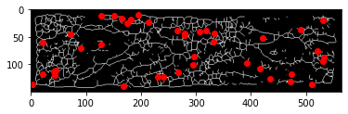
mask = np.array([[0,0,0],[0,1,1],[0,0,0]])
mask = mask==1
x,y = np.where(binary==1)
plt.imshow(binary, cmap='gray')
for i in range(x.shape[0]):
val = binary[x[i]-1:x[i]+2,y[i]-1:y[i]+2]
s = np.sum(val==mask)
if(s==9):
plt.plot(y[i],x[i],'ro')
plt.show()

Slide 23
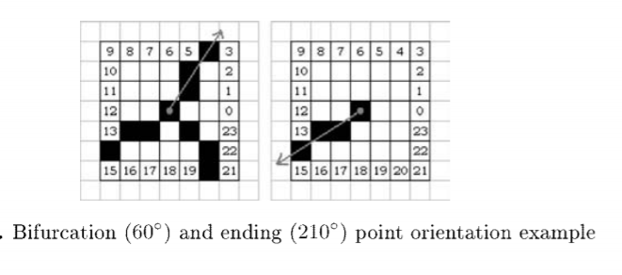
Matching
Non-alignment of minutiae
One possible option to compute orientation and use Hough transform to determine possible translation , rotation and scale shifts between set of minutiae points

Slide 24
Vein Database - https://www.idiap.ch/dataset/vera-fingervein

